Slide 1
VIRTUAL METAVERSE PROJECT PROPOSAL
Here is where your presentation begins

Slide 2
Contents of this template
This is a slide structure based on a project proposal presentation
You can delete this slide when you’re done editing the presentation
Fonts | To view this template correctly in PowerPoint, download and install the fonts we used
Used and alternative resources | An assortment of graphic resources that are suitable for use in this presentation
Thanks slide | You must keep it so that proper credits for our design are given
Colors | All the colors used in this presentation
Infographic resources | These can be used in the template, and their size and color can be edited
Customizable icons | They are sorted by theme so you can use them in all kinds of presentations
For more info: SLIDESGO | SLIDESGO SCHOOL | FAQS
You can visit our sister projects: FREEPIK | FLATICON | STORYSET | WEPIK | VIDFY

Slide 3
Table of contents
01.
02.
03.
The project
Requirements
Project goals
04.
05.
06.
Sneak peek
Stages
Our team
You can describe the topic of the section here
You can describe the topic of the section here
You can describe the topic of the section here
You can describe the topic of the section here
You can describe the topic of the section here
You can describe the topic of the section here

Slide 4
Our company
You can give a brief description of the topic you want to talk about here. If you want to talk about Mercury, you can say that it’s the smallest planet

Slide 5
What are we working on?
Venus
Mars
Mercury
Venus is the second planet from the Sun
Despite being red, Mars is a cold place
Mercury is the closest planet to the Sun

Slide 6
01
About the project
You can enter a subtitle here if you need it

Slide 7
About
the project
Do you know what helps you make your point crystal clear? Lists like this one:
They’re simple
You can organize your ideas clearly
You’ll never forget to buy milk!
And the most important thing: the audience won’t miss the point of your presentation

Slide 8
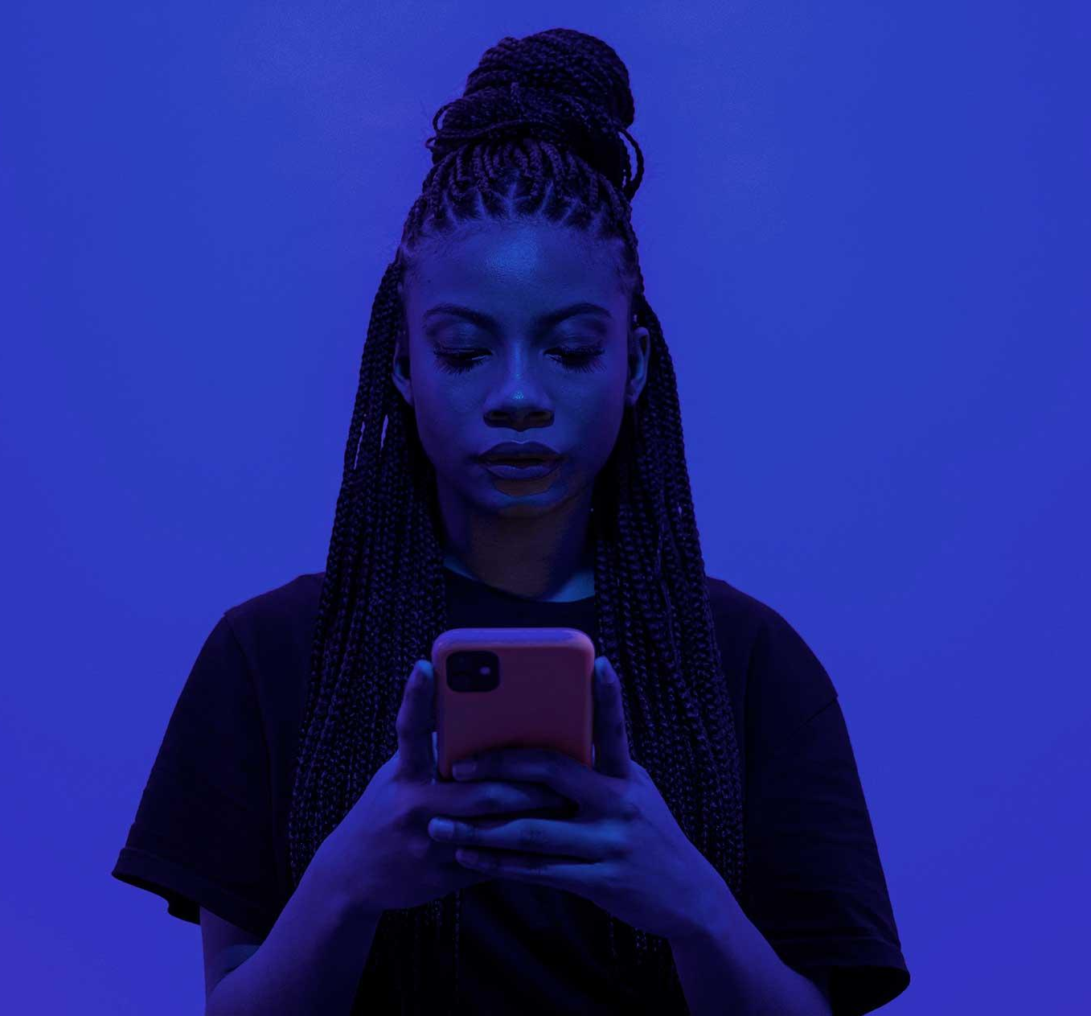
Now
Mercury is the smallest planet in the Solar System. Its name has nothing to do with the liquid metal

Slide 9
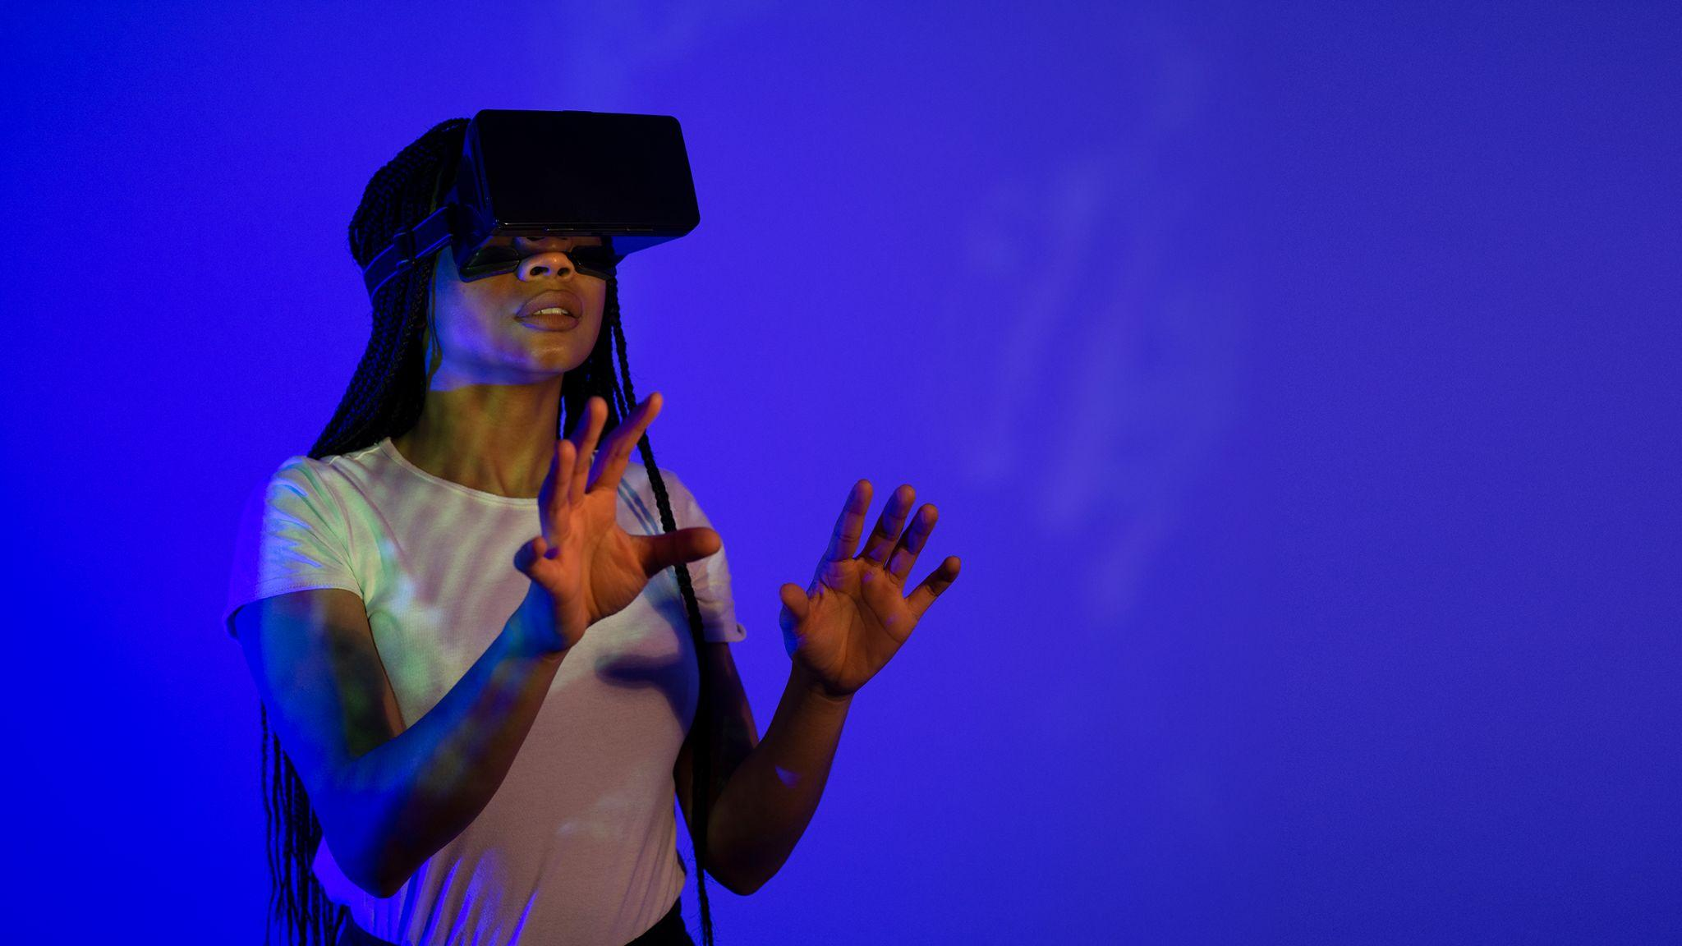
Future
Venus has a beautiful name and is the second planet from the Sun. It’s terribly hot, even hotter than Mercury

Slide 10
—Someone Famous
“This is a quote, words full of wisdom that someone important said and can make the reader get inspired.”

Slide 11
Major requirements
Venus
Jupiter
Mars
Saturn
Venus is the second planet from the Sun
It’s the biggest planet in the Solar System
Despite being red, Mars is a very cold place
Saturn is a gas giant and has several rings

Slide 12
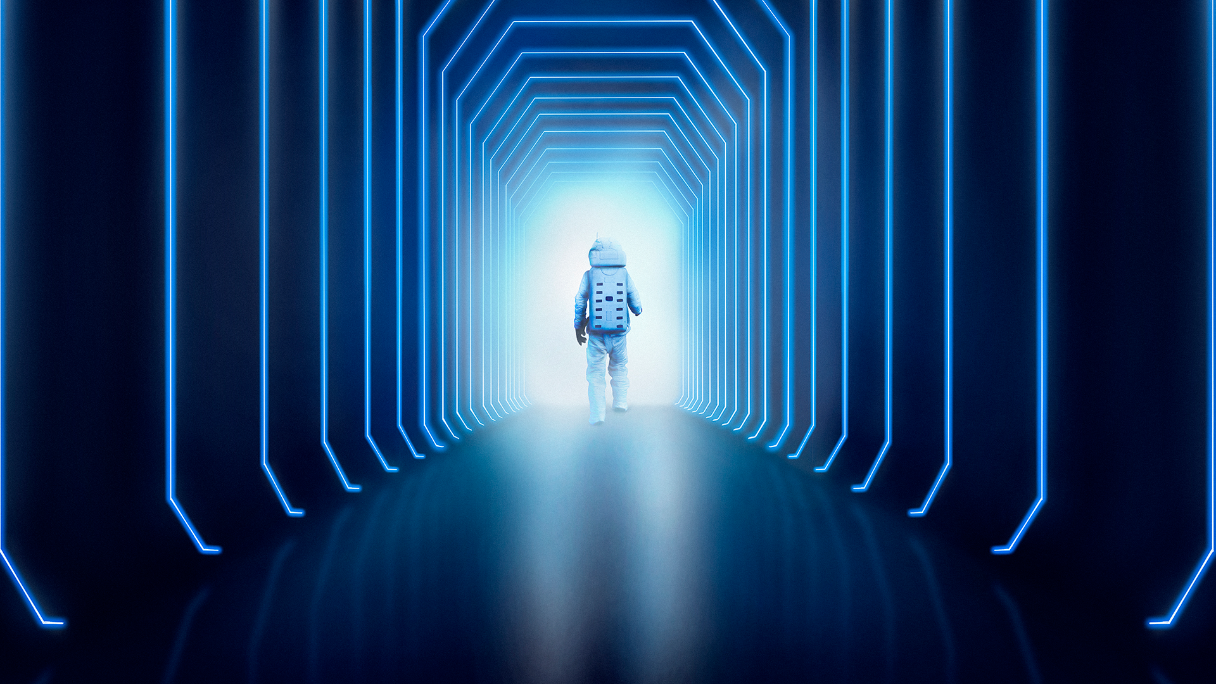
A picture is worth a thousand words

Slide 13
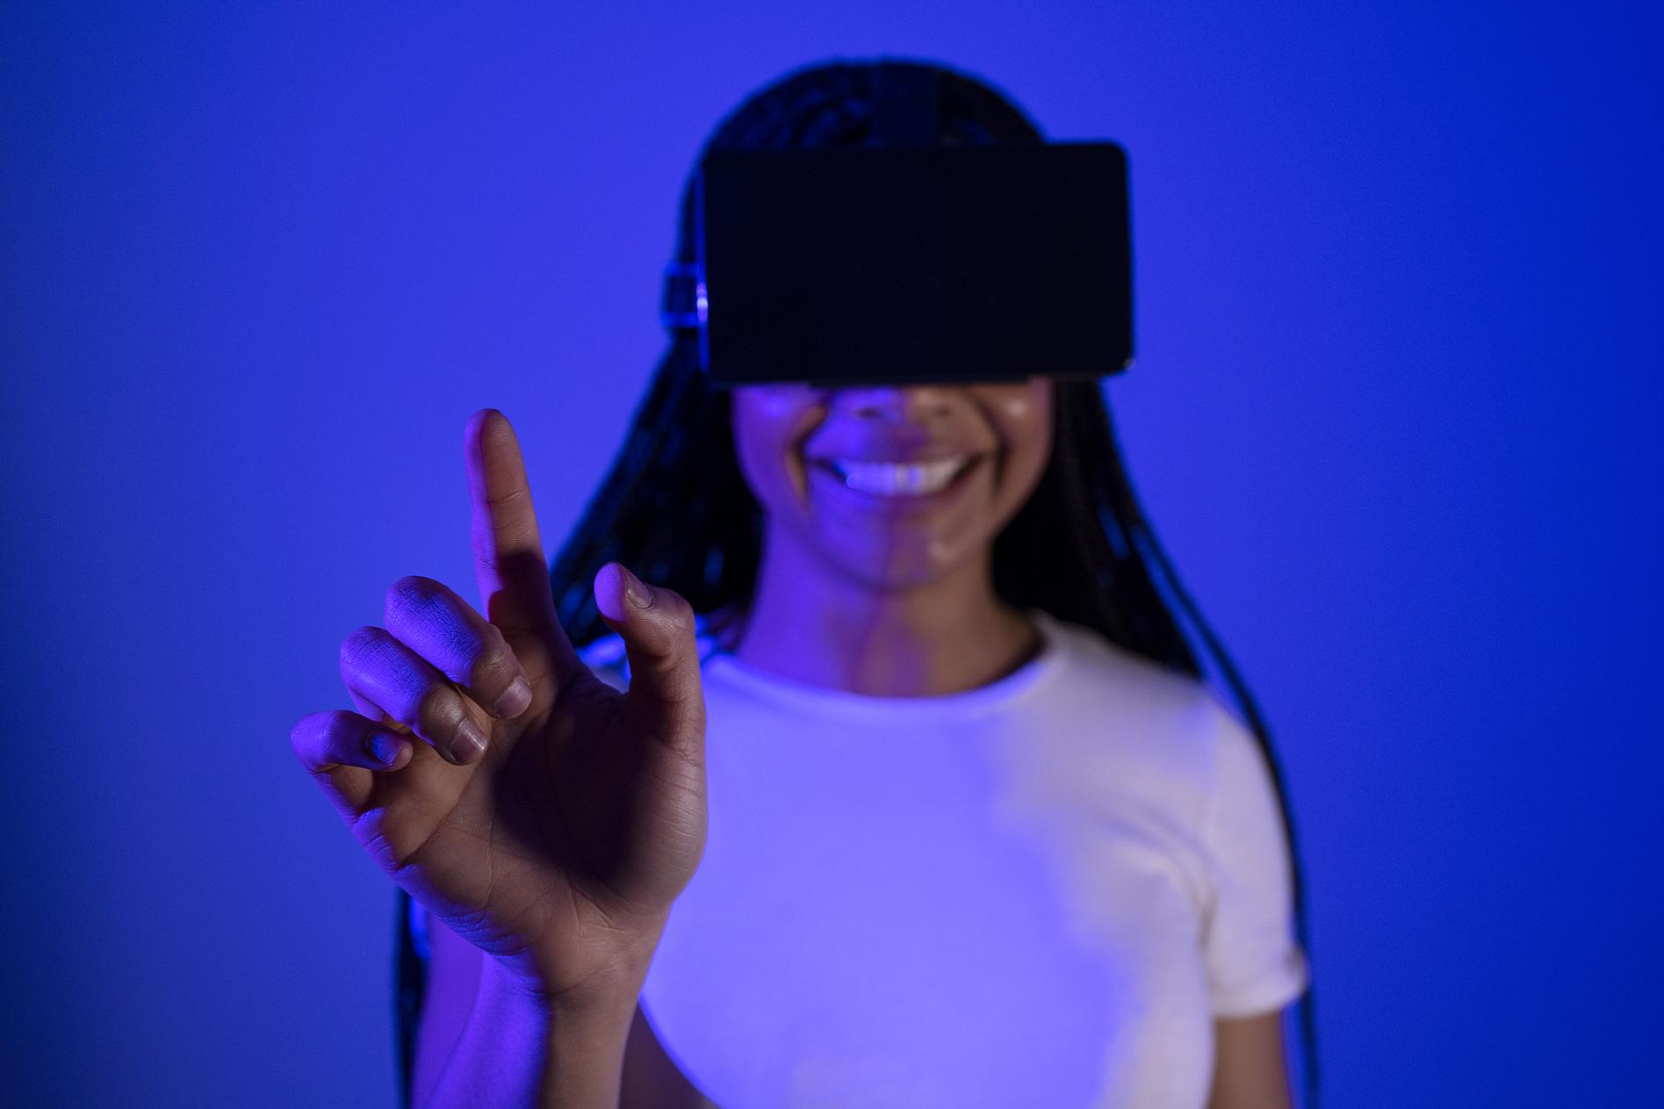
A picture always reinforces the concept
Images reveal large amounts of data, so remember: use an image instead of a long text. Your audience will appreciate it

Slide 14
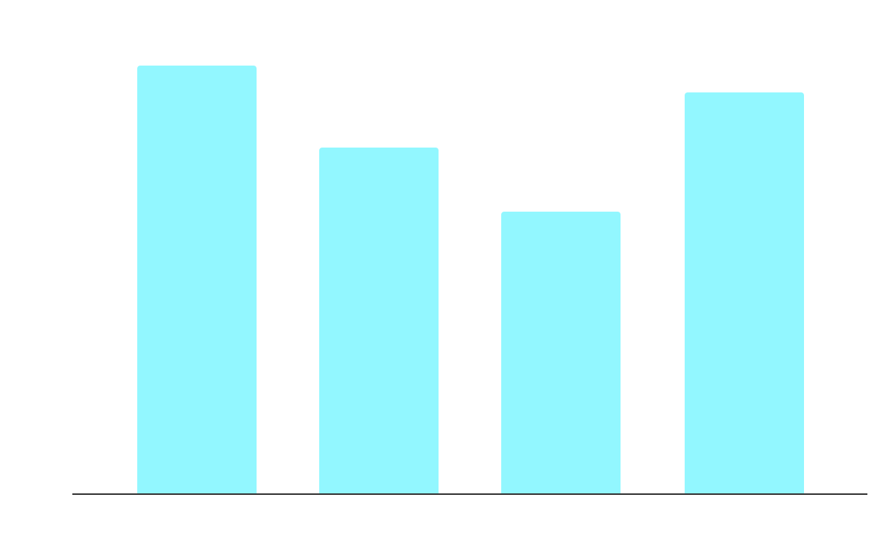
Budget
$50,000,000
Budget 1
Budget 2
34%
35%
Budget 3
Budget 4
11%
38%
Follow the link in the graph to modify its data and then paste the new one here. For more info, click here

Slide 15
Project goals
Goal 1
Goal 2
Goal 3
Venus has a beautiful name, but also high temperatures
Mercury is the closest planet to the Sun and the smallest one
Mars is actually a cold place. It’s full of iron oxide dust

Slide 16
Awesome words

Slide 17
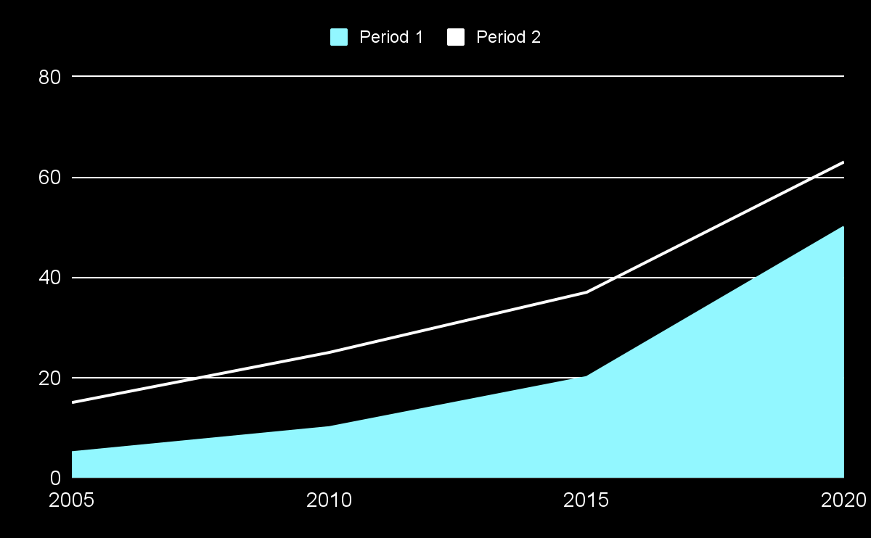
Predicted results
$20,000
1,000
Expected income
New employees
75%
50%
Venus has high temperatures
Mars is a very cold place
Follow the link in the graph to modify its data and then paste the new one here. For more info, click here

Slide 18
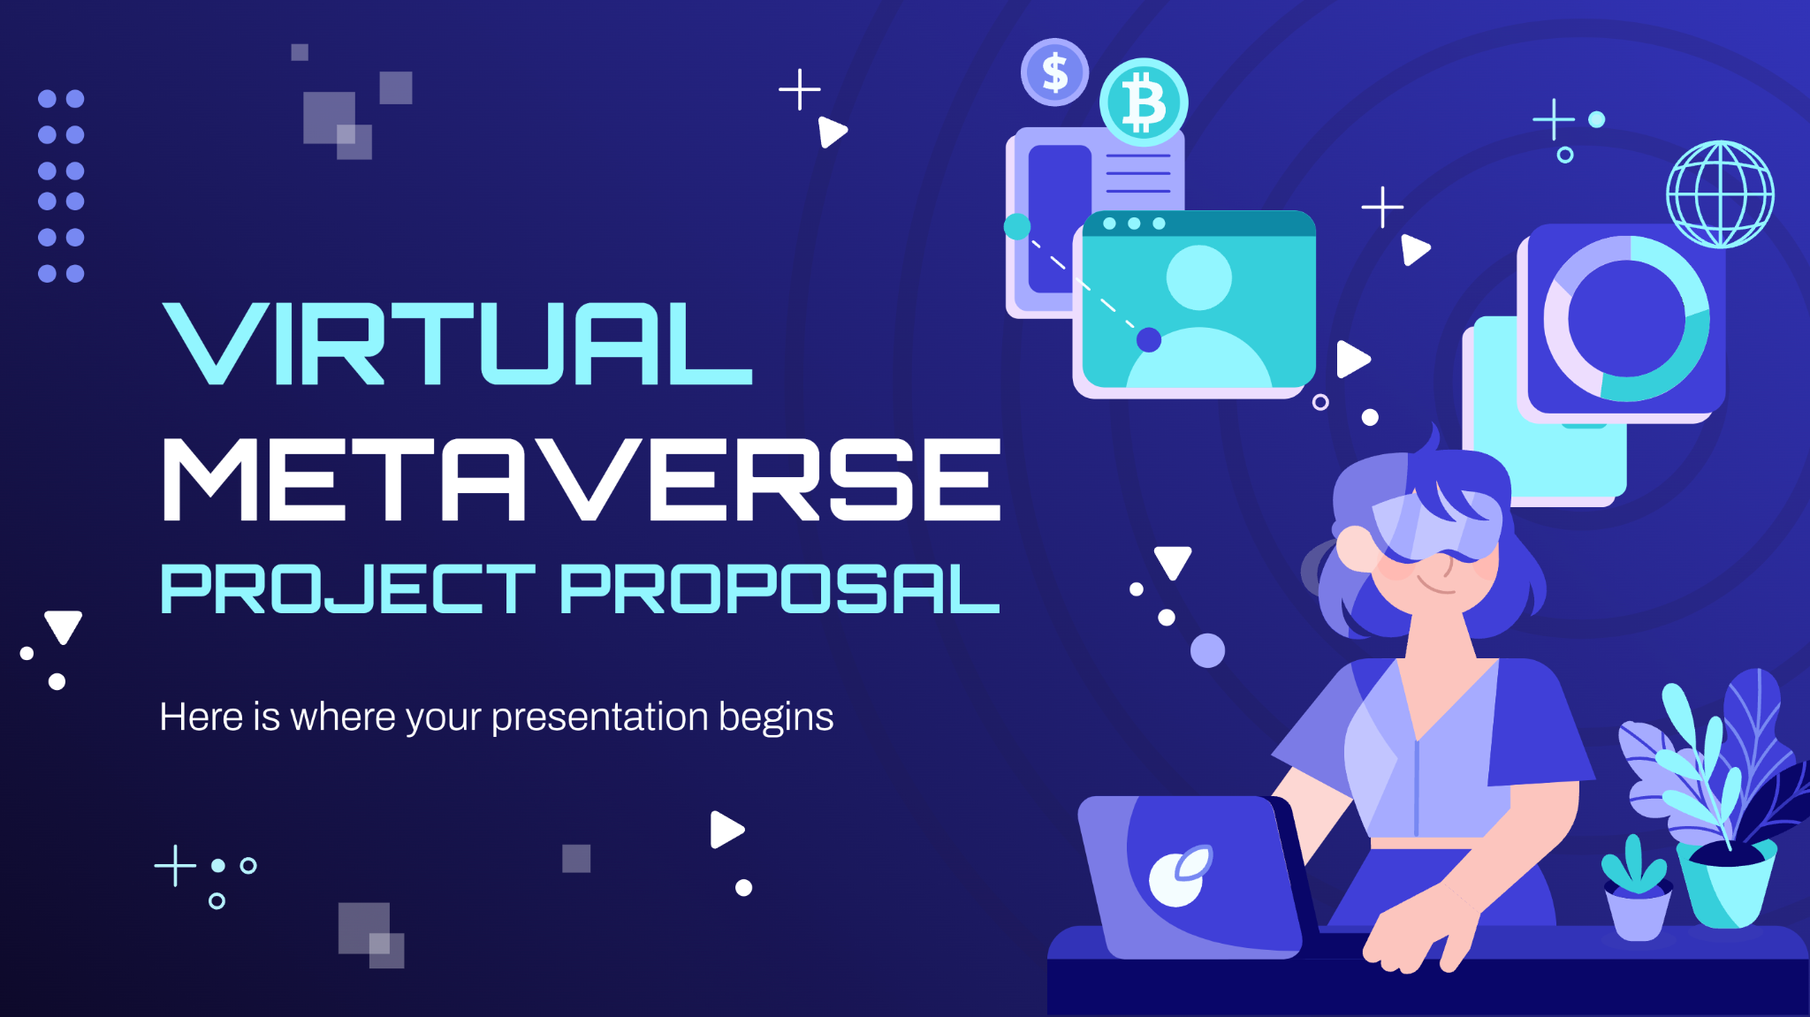
Sneak peek
You can replace the image on the screen with your own work. Just right-click on it and select “Replace image”

Slide 19
Project stages
Stages | Jan | Feb | Mar | Apr | May | Jun
Stage 1
Stage 2
Stage 3
Venus has high temperatures
Mars is a very cold place
Jupiter is the biggest planet of them all

Slide 20
Our partners
Venus
Jupiter
Venus is a
hot planet
Jupiter is the biggest planet
Mars
Saturn
Mars is a very cold place
It’s a gas giant and has rings

Slide 21
150,000
Big numbers catch your audience’s attention

Slide 22
Our timeline
Day 1
Day 2
Day 3
Day 4
Day 5
Venus has high temperatures
Mars is a very cold place
Jupiter is the biggest planet
Mercury is the smallest planet
Neptune is far away from us

Slide 23
Project summary
Mercury
Venus
Mars
Neptune
Jupiter
Saturn
1
4
Mercury is the closest planet to the Sun
Venus is the second planet from the Sun
2
5
Despite being red, Mars is very cold
Neptune is the farthest planet from the Sun
3
6
Jupiter is the biggest planet of them all
It’s composed of hydrogen and helium

Slide 24
Project objectives
Objective 1
Objective 2
Mercury is the closest planet to the Sun and the smallest one in the Solar System—it’s only a bit larger than the Moon
Venus has a beautiful name and is the second planet from the Sun. It’s hot and has a poisonous atmosphere

Slide 25
Project infographics
Venus
Jupiter
Venus is a very hot planet
Jupiter is the biggest planet
Mars
Saturn
Mars is a very cold place
It’s a gas giant and has rings

Slide 26
Our percentages
25%
50%
75%
Mercury is the closest planet to the Sun
Despite being red, Mars is a cold place
Neptune is the farthest planet from the Sun

Slide 27
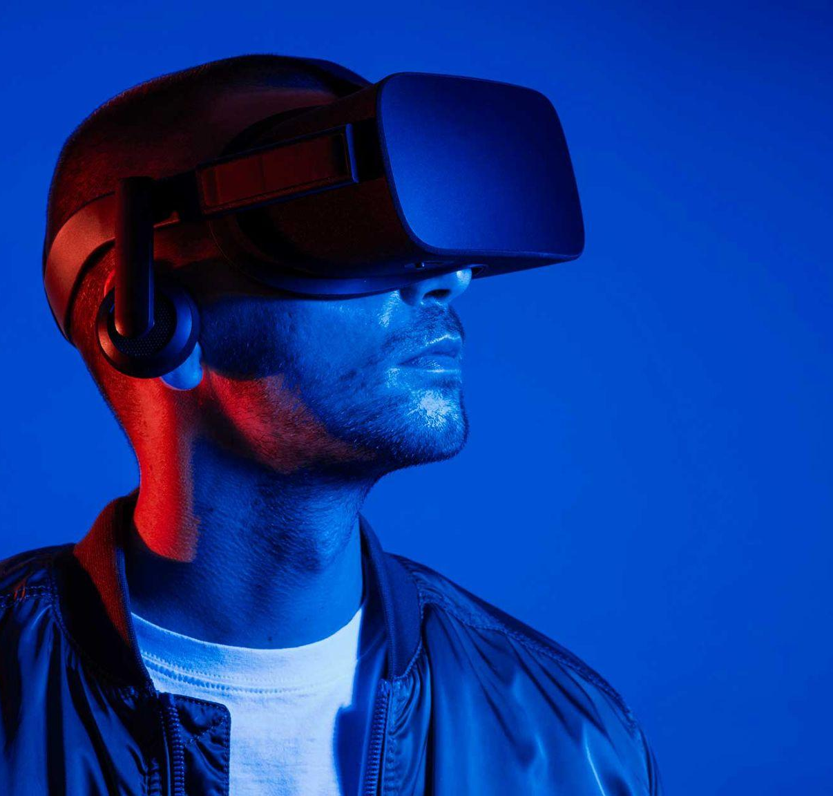
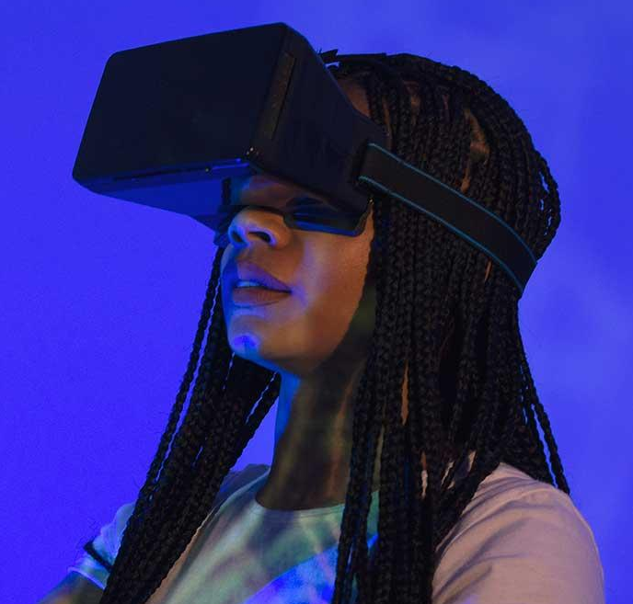
Our team
Joe Jimmy
Sue Doe
You can talk a bit about this person here
You can talk a bit about this person here

Slide 28
Thank you!
Do you have any questions?
youremail@freepik.com
+91 620 421 838
yourwebsite.com
Please keep this slide for attribution

